Slide 1
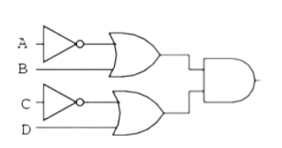
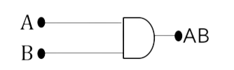
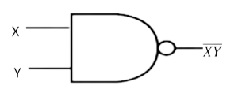


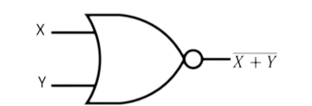
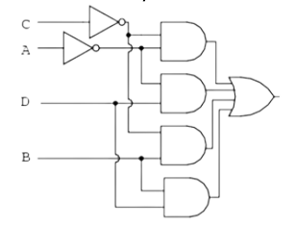
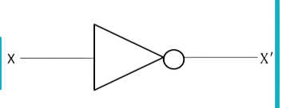
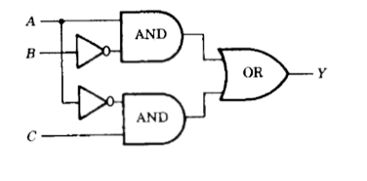
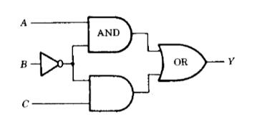

DBM20153-DISCRETE MATHEMATICS
Chapter 4

Slide 2
Chapter 4: BOOLEAN ALGEBRA
4.1 Explain Boolean Functions
4.1.1 Use identities of Boolean algebra
4.2 Convert logic circuits as Boolean Algebra
4.3 Construct truth tables from Boolean functions
4.4 Apply Karnaugh maps
4.4.1 Case of two variables
4.4.2 Case of three variables

Slide 3
BOOLEAN FUNCTION
A Boolean function is decribed by an algebraic expression called Boolean expression which consists of binary variables, the constants 0 and 1, and the logic operation symbols.
Example:
F (A, B, C, D) = A + BC + ADC
Boolean Function
  Also known as output
Boolean Function

Slide 4
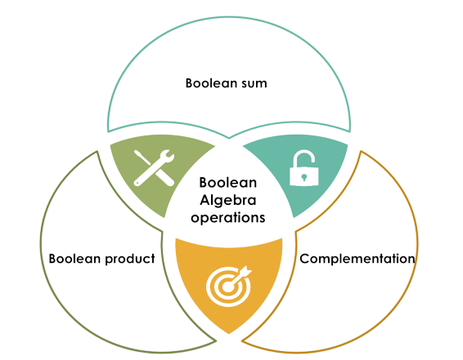

Slide 5
Boolean Sum
  The Boolean sum, denoted by + or by OR
Example:
0 + 0 = 0
0 + 1 = 1
1 + 0 = 1
1 + 1 = 1 (the highest output cannot exceed 1)
  It can be completely described using a truth table. For example, if we have two variables as the input (X and Y) and one output (denoted as F), the truth table as shown below:
X
Y
F=X+Y
0
0
0
0
1
1
1
0
1
1
1
1

Slide 6
Boolean Product
  The Boolean product, denoted by • or by AND, has the following values:
Example:
0 • 0 = 0
1 • 1 = 1
  It can be completely described using a truth table. For example, if we have two variables as the input (X and Y) and one output (denoted as F), the truth table as shown below:
X
Y
F=X•Y
0
0
0
0
1
0
1
0
0
1
1
1

Slide 7
Complementation
  The complement of an element also read as NOT. The NOT operation is most often designated by a prime mark (𝑿′) . It is sometimes indicated by an overbar (𝑿).
  It can be completely described using a truth table. For example, if we have one variable as the input (X), the complement of the input X are shown below:
X
X′
0
1
0
0

Slide 8
EXAMPLE
Find the value of
1.0 + (0 + 1)
Solution:
By using the definition of Boolean sum, Boolean product and complement;
1.0 + (0 + 1)
= 0 + (1)
= 0 + 0
= 0

Slide 9

EXERCISE A
Find the value of of these expressions
$1∙\overline{0}$
$1+\overline{1}$
$\overline{0}∙0$
$\overline{1+0)}$

Slide 10
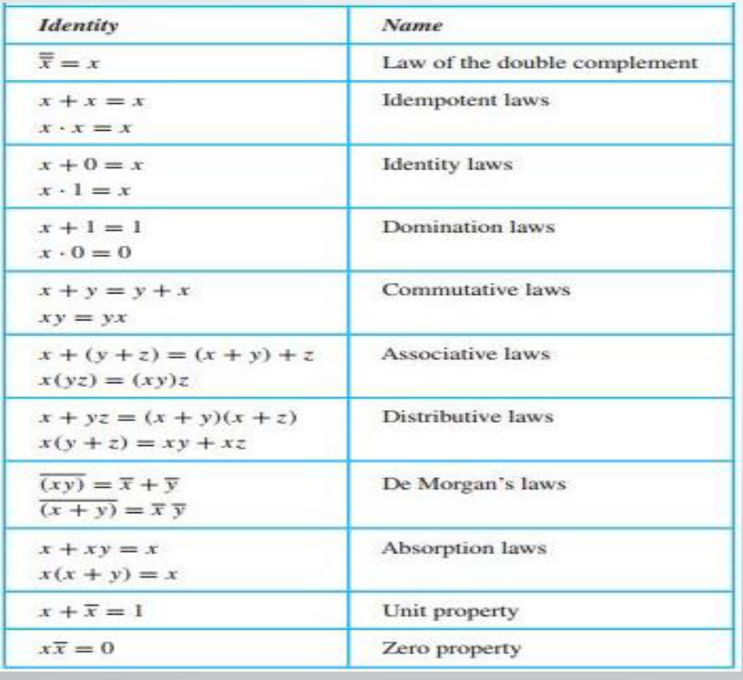
4.1.1 USE IDENTITIES OF BOOLEAN ALGEBRA

Slide 11
EXAMPLE
Simplify the following Boolean expression by using Boolean identities (refer to the table);
𝐹 𝐴, 𝐵, 𝐶 = (𝐴 + 𝐵) (𝐴 + 𝐶)
Solution:
(𝐴 + 𝐵) (𝐴 + 𝐶) = 𝐴𝐴 + 𝐴𝐶 + 𝐵𝐴 + 𝐵𝐶 Expansion of the bracket
= 𝐴 + 𝐴𝐶 + 𝐵𝐴 + 𝐵𝐶
= 𝐴(1 + 𝐶) + 𝐵(𝐴 + 𝐶) Factorizing the common factor A,B
= 𝐴(1) + 𝐵(𝐴 + 𝐶)
= 𝐴 + 𝐴𝐵 + 𝐵𝐶 Expansion of the bracket
= 𝐴(1 + 𝐵) + 𝐵𝐶 Factorizing the common factor A
= 𝐴(1) + 𝐵𝐶
= 𝐴 + 𝐵𝐶
Distributive Law
Idempotent Law
Unit property
Distributive Law
Distributive Law
Unit property
Distributive Law

Slide 12
EXAMPLE
Simplify the following Boolean expression by using the suitable identities (refer to the table):
𝐹 (𝐴, 𝐵) = 𝐴 + 𝐴𝐵
Solution:
𝐹 (𝐴, 𝐵) = 𝐴 + 𝐴𝐵
= (𝐴 + 𝐴𝐵) + 𝐴𝐵
= 𝐴 + 𝐴𝐵 + 𝐴𝐵
= 𝐴 + 𝐵(𝐴 + 𝐴) Factorizing the common factor B
= 𝐴 + 𝐵(1)
= 𝐴 + 𝐵
Absorption Law
Distributive Law
Distributive Law
Unit property

Slide 13

example
Simplify the following Boolean expression by using the suitable identities (refer to the table):
$$Y=ABC+A\overline{B}C+\overline{A}$$
Solution:
$Y=ABC+A\overline{B}C+\overline{A}$
$=AC\left(B+\overline{B}\right)+\overline{A}$
$=AC\left(1\right)+\overline{A}$
$=AC+\overline{A}$ $+ \overline{A}C$
= $C$($\overline{A}+A)+$
= $C +\overline{A}$
=$\overline{A}+$ $C$

Slide 14
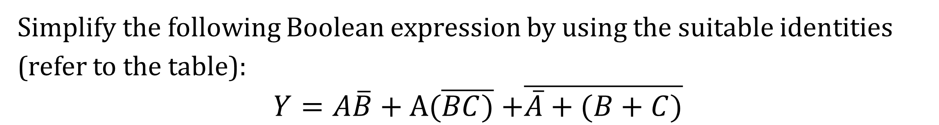
Try this!
Simplify the following Boolean expression by using the suitable identities (refer to the table):
$Y=A\overline{B}+A(\overline{BC)}$ $+\overline{\overline{A}+(B+C)}$

Slide 15
p\to q
Exercise B
Simplify the following Boolean expression:
a)C + BC
b)AB(A + B)(B + B)
c) (x + y) (xz + xz′) + xy + y
d) x (x + y) + (y + xx)(x + y)

Slide 16
4.2 Define Logic Gates
A logic gate is a building block of a digital circuit. Most logic gates have two inputs and one output and are based on Boolean algebra.
At any given moment, every terminal is in one of the two binary conditions:
  Low (0)
  High (1)

Slide 17
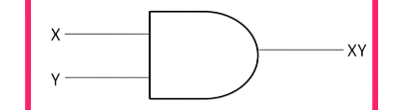
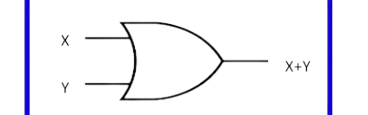
Logic Gates
The Inverter
The AND Gate
The OR Gate
Performs the Boolean NOT operation (refer to the slide no. 7).
Performs the Boolean AND operation (refer to the slide no. 4).
Performs the Boolean OR operation (refer to the slide no. 5).

Slide 18
The NAND Gate
The NOR Gate
Performs the Boolean NOT-AND operation. It produces a LOW output (0) when all inputs are HIGH (1). For a 2-input gate, the truth table is:
Performs the Boolean NOT-OR operation. It produces a LOW output (0) when ANY input is HIGH (1). For a 2-input gate, the truth table is:
X
Y
F=XY
X
Y
F=X+Y
0
0
1
0
0
1
0
1
1
0
1
0
1
0
1
1
0
0
1
1
0
1
1
0

Slide 19
4.2 Logic circuits
  In a Combinational Logic Circuit, the output is dependent at all times on the combination of its inputs.
  Combinational Logic Circuits are made up from basic logic NAND, NOR and NOT gates that are “combined” or connected together to produce more complicated switching circuits.
  The NAND and NOR gates are also known as “universal” gates.
  The three main ways of specifying the function of a combination logic circuit are:
  Boolean algebra
  Truth table
  Logic Diagram (graphical representation of logic circuit)

Slide 20
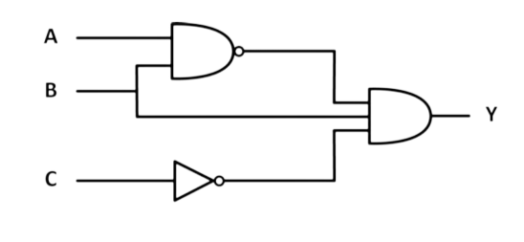
4.2 CONVERT LOGIC CIRCUITS AS BOOLEAN ALGEBRA
A logic circuit diagram uses the graphical representation or description of logic gates to represent a logic expression. An example of logic circuit diagram, shows below with three inputs (A, B, and C) and one output (Y).

Slide 21
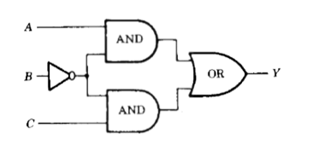
Example 2C
  1 Express the output Y as a Boolean expression in the inputs A, B and C for the logic circuit below:
a)
b)
2. Draw a logic circuit
corresponding to the Boolean
expression:
a) Y = AB+𝐴𝐶
b) Y=(x + y)𝑥

Slide 22
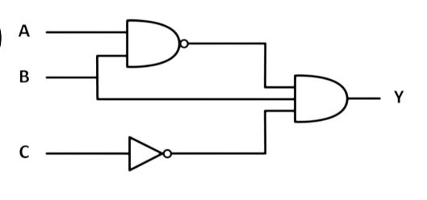
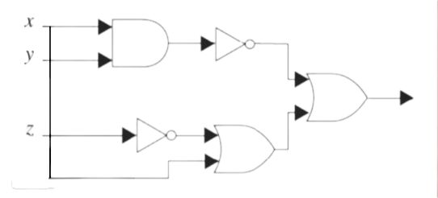
p\to q
Exercise C
  1.Find the output of the given circuits:
a)
b)
2.Draw a logic circuit corresponding to the Boolean expression:
a) Y = (A+B)C
b) Y = 𝐴 + 𝐵𝐶 + 𝐷
c) A + BC + B
d) Y = A′B + A + C

Slide 23

For any of the four possible input conditions, we can generate a HIGH output (1) by using an AND gate and inverter with the appropriate inputs to generate the requires AND product. Refer to the FOUR examples below:
Example 1
Example 2
  Inputs: A and B; Output:𝐴𝐵
*AND gate means the product for
BOOLEAN operation
  The truth table:
  BOTH low input (0) by using AND gate and inverter generate HIGH output (1)
  Inputs: A and B; Output:AB
*AND gate means the product for
BOOLEAN operation
  The truth table:
  ONE low input (0) by using AND gate and inverter generate HIGH output (1)
A
B
AB
A
B
AB
0
0
1
0
1
1

Slide 24
Example 3
Example 4
  Inputs: A and B; Output:AB
*AND gate means the product for
BOOLEAN operation
  The truth table:
  ONE low input (0) by using AND gate and inverter generate HIGH output (1)
  Inputs: A and B; Output:AB
*AND gate means the product for
BOOLEAN operation
  The truth table:
  BOTH high input (1) by using AND gate and inverter generate HIGH output (1)
A
B
AB
A
B
AB
1
0
1
0
0
1

Slide 25
EXAMPLE
Design a logic circuit that has three inputs, A, B, and C, and whose output will be HIGH only when a majority of the inputs are HIGH.
Solution:
Step 1
Set up the truth table. On the basis of the problem statement, the output 𝐗 should be 1 whenever two or more inputs are 1; for all other cases, the output should be 0.

Slide 26
A | B | C | X
0 | 0 | 0 | 0
0 | 0 | 1 | 0
0 | 1 | 0 | 0
0 | 1 | 1 | 1
1 | 0 | 0 | 0
1 | 0 | 1 | 1
1 | 1 | 0 | 1
1 | 1 | 1 | 1
Boolean expression
ABC
ABC
ABC
ABC
Step 2
Write the AND term for each case where the output is a 1. There are four such cases. Refer to the TRUTH TABLE above.

Slide 27
Step 3. Write the sum-of-products expression for the output.
X = ABC + ABC + ABC + ABC
Step 4. Simplify the output expression.
This expression can be simplified in several ways. Perhaps the quickest way is to realize that the last term 𝐴𝐵𝐶 has two variables in common with each of the other terms. Thus, we can use the 𝐴𝐵𝐶 term to pair with each of the other terms. The expression is rewritten with the 𝑨𝑩𝑪 term occurring three times.
X = ABC + ABC + ABC + ABC + ABC + ABC
Factoring the appropriate pairs of terms, we have
X = BC(A + A) + AC(B + B) + AB(C + C)
Each term in parentheses is equal to 1, so we have
X = BC + AC + AB

Slide 28
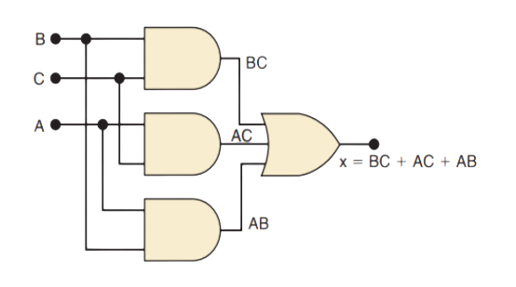
Step 5. Implement the circuit for the final expression.
Since the expression is in SOP(Sum of product) form, the circuit consists of a group of AND gates working into a single OR gate.

Slide 29
IMPORTANT: Method for constructing truth tables for Boolean
The number of rows in the truth table is 2ⁿ where n is the number of input/variables.
Example:
If we have two inputs (A and B), therefore, we will have 2² = 4 rows. If we have three inputs(A, B and C), therefore we will have 2³ = 8 rows.
Look at the picture below:
Two inputs
Three inputs
A
B
A
B
C
1
1
1
1
1
1
1
0
1
1
0
1
0
1
0
0
0
1
0
1
1
0
1
0
0
0
0
0
1
0
0
0

Slide 30
EXAMPLE
Find the values of the Boolean function represented by
𝐹 (𝑥, 𝑦, 𝑧) = 𝑥𝑦 + 𝑧′
Solution:
We need to construct the truth table:
x
y
z
xy
z′
F = xy + z′
1
1
1
1
0
1
1
1
0
1
1
1
1
0
1
0
0
0
1
0
0
0
1
1
0
1
1
0
0
0
0
1
0
0
1
1
0
0
1
0
0
0
0
0
0
0
1
1

Slide 31
p\to q
Exercise D
Find the truth table 𝑇 for the equivalent Boolean expression:
𝐹(𝐴, 𝐵, 𝐶) = 𝐴𝐵𝐶′ + 𝐵𝐶′ + 𝐴′𝐵

Slide 32



Define the minimization of circuits
The process of simplifying the algebraic expression of a Boolean function is called minimization. It is clear from the following image that the minimized version of the expression takes a less number of logic gates and also reduces the complexity the circuit substantially.
By simplifying the output using Boolean identities:
$\overline{A}\overline{C}+\overline{A}D$+ $\overline{C}B+BD$
= $\overline{A}$($\overline{C}+D$) + $B(\overline{C}$+D)
= ($\overline{A}+B$)($\overline{C}$+D)
Therefore, we can draw new LOGIC DIAGRAM as below:
D
Output = $\overline{A}\overline{C}+\overline{A}D$+ $\overline{C}B$ + BD
Output = ($\overline{A}+B$)($\overline{C}$+D)

Slide 33
4.4 Use the Karnaugh Map method in Two or Three Variables
KARNAUGH MAPS
  Used to facilitate converting between Truth Tables and Boolean Expressions
  Make deriving a Boolean Expression much easier because they are graphical
  Map TWO or MORE inputs to one output
  Number of cells = 2ⁿ. Example: if we have 2 inputs, 2² = 4 cells

Slide 34
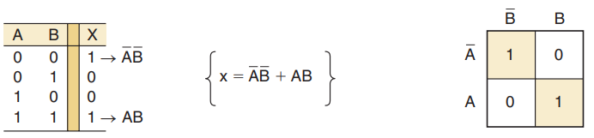
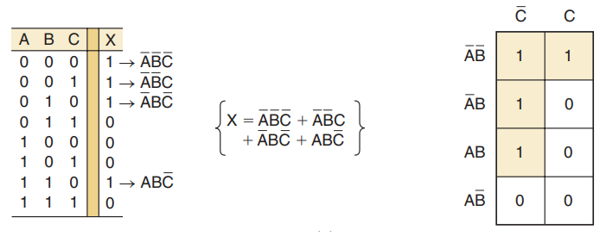
Example 1: K Map of 2 variables/inputs
1 | 0
0 | 1
Example 2: K Map of 3 variables/inputs
0 | 1 | 0 | 0
0 | 1 | 1 | 1

Slide 35
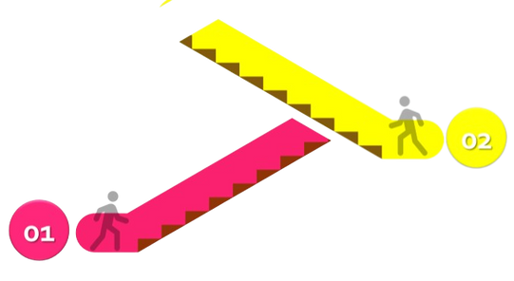
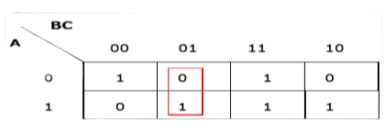
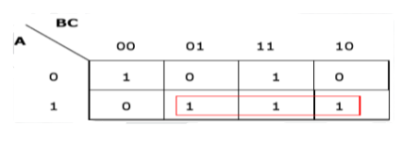
4.4 Apply the Karnaugh Map in Minimization of the Circuits
There are 7 rules used for the simplication of Boolean expressions. Refer to the explanation below:
RULE 1:
Any cell containing a zero cannot be grouped.
RULE 2:
Groups must contain 2n cells (n starting from 1).
WRONG GROUPING
WRONG GROUPING

Slide 36
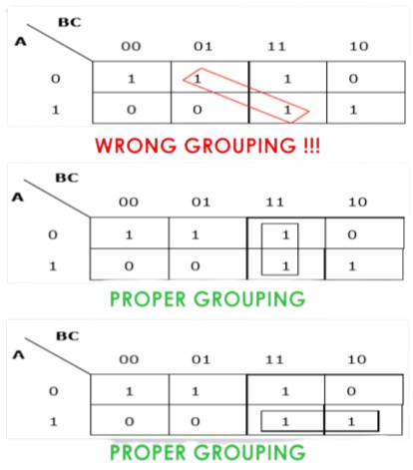
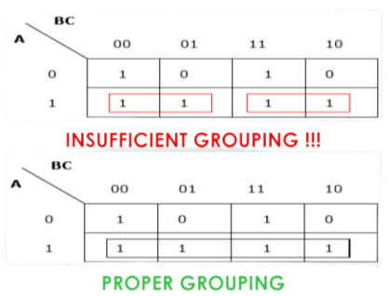
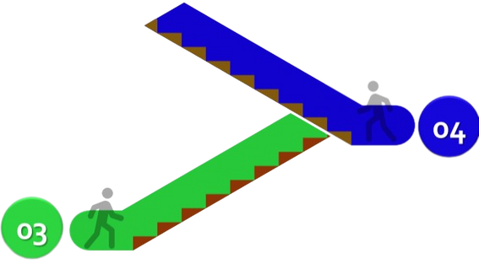
RULE 3:
Grouping must be horizontal or vertical, but must not be diagonal.
RULE 4:
Groups must be covered as largely aspossible.

Slide 37
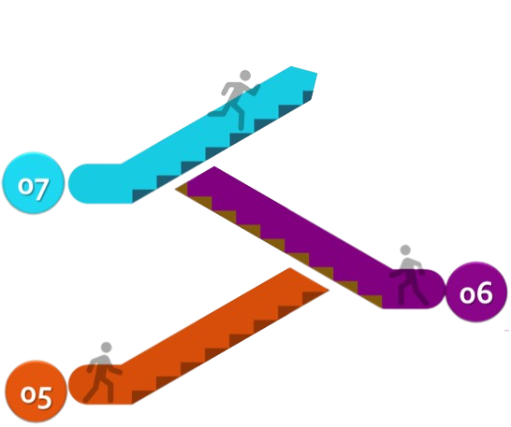
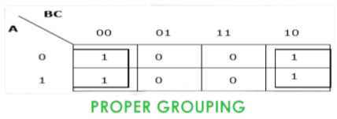
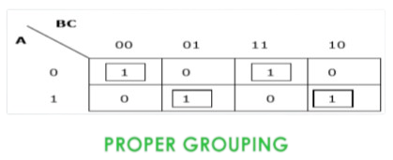
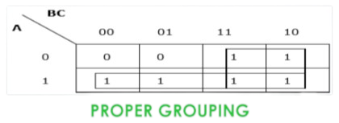
RULE 7:
The leftmost cell/cells can be grouped with the rightmost cell/cells and the topmost cell/cells can be grouped with the bottommost cell/cells.
RULE 6:
Groups may overlap but there should be as few groups as possible.
RULE 5:
If 1 of any cell cannot be grouped with any other cell, it will act as a group itself.

Slide 38
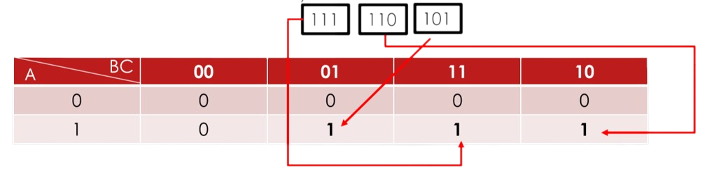
EXAMPLE
Minimize the following Boolean expression by using K-map.
F(A,B,C)=ABC+ABC’+AB’C
Solution:
First, we need to SOP (Sum of Product) for the Boolean expression given:
F(A,B,C)= ABC + ABC’ + AB’C
*OTHER THAN THAT, WE PUT 0 IN THE TABLE.

Slide 39
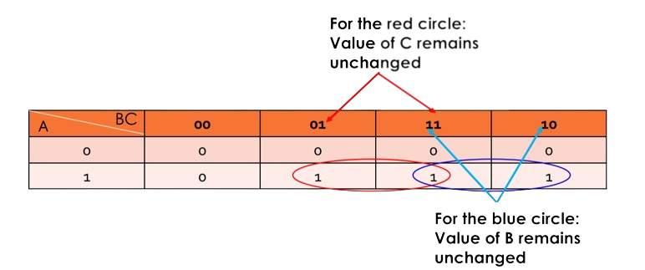
Therefore; F(A,B,C) = AC + AB
Red circle Blue circle

Slide 40
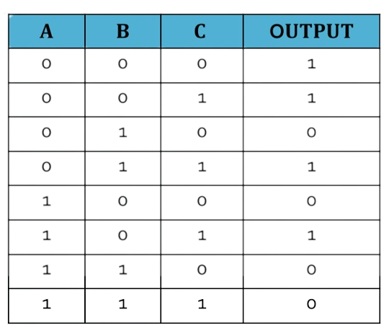
Exercise E
Here is a truth table for a specific three input logic circuit.
Draw a K Map according to the values found in the truth table.

Slide 41
Exercise E cont...
2. Use Karnaugh maps to find the minimal form for each expression.
a) xy + xy’
b) xy + x’y + x’y’
c) xy’ + x’y’
d) xyz’ + xy’z + xy’z’ + x’yz + x’yz’ + x’y’z
e) xyz + xyz’ + x’yz + x’y’z
f) xyz + xyz’ + xy’z + xy’z’ + x’y’z
3. Design a minimal AND-OR circuit which yields the following truth
table:
𝑇 = [𝐴 = 00001111, 𝐵 = 00110011,
𝐶 = 01010101, 𝐿 = 10101001]

Slide 42
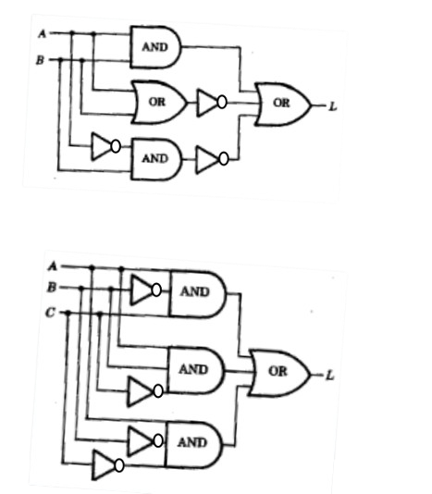
Exercise D cont...
4. Redesign the following circuit so that it becomes a minimal
AND-OR circuit
a)
b)

Slide 43
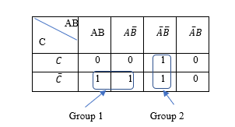

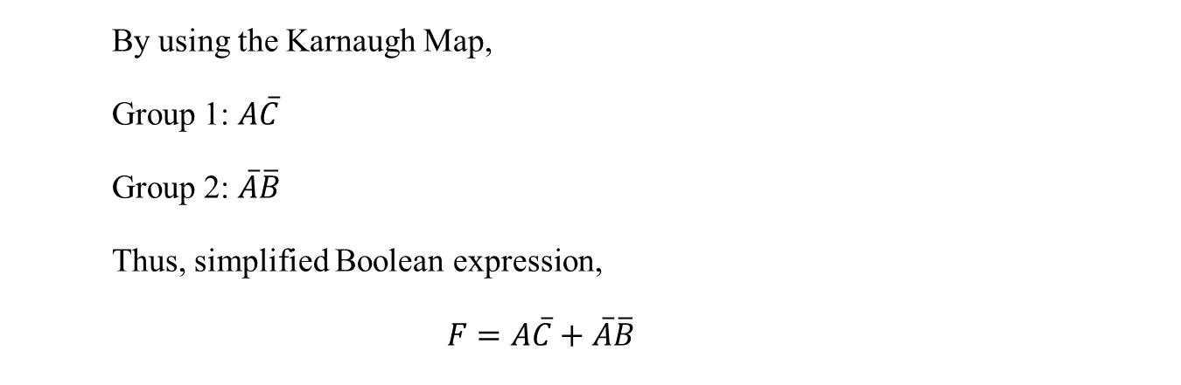
Additional notes of k-maps
Mapping a standard SOP Expression
For an SOP expression in standard form, a 1 is placed on the Karnaugh map for each product term in the expression. Each 1 is placed in a cell corresponding to the value of a product term.
Example: $\overline{A}\overline{B}\overline{C}+\overline{A}\overline{B}C+AB\overline{C}+A\overline{B}\overline{C}$
By using the Karnaugh Map,
Group 1: $A\overline{C}$
Group 2: $\overline{A}\overline{B}$
Thus, simplified Boolean expression,
$$F=A\overline{C}+\overline{A}\overline{B}$$

Slide 44
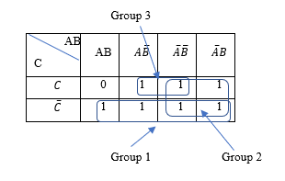


Additional notes of k-maps
Mapping a Nonstandard SOP Expression
For an SOP expression in nonstandard form, it has one or more missing variables. It means each product term does not have three variables.
Example:$\overline{ A}+A\overline{B}+AB\overline{C}$
By using the Karnaugh Map,
Group 1: $\overline{C}$
Group 2: $\overline{A}$
Group 3 : $\overline{B}C$
Thus, simplified Boolean expression,
$$F=\overline{A}+\overline{C}+\overline{B}C$$

Slide 45
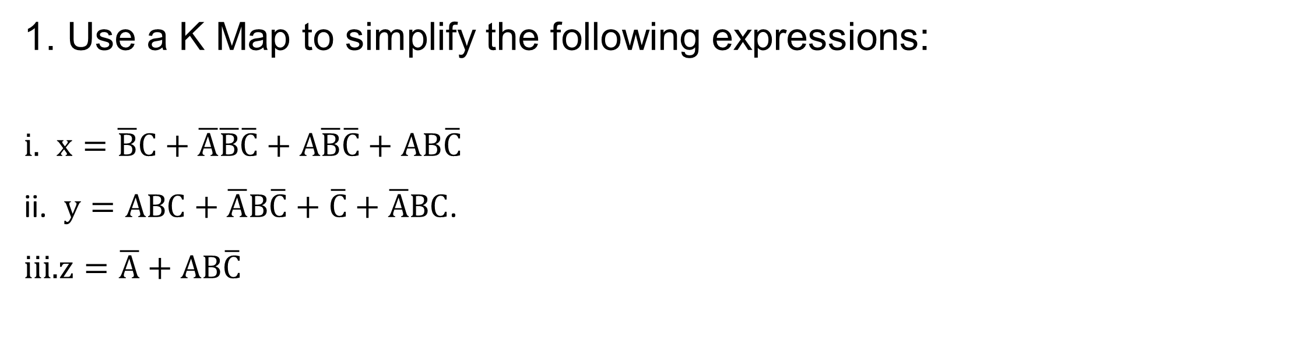
Additional exercises
1. Use a K Map to simplify the following expressions:
$x=\overline{B}C+\overline{A}\overline{B}\overline{C}+A\overline{B}\overline{C}+AB\overline{C}$
$y=ABC+\overline{A}B\overline{C}+\overline{C}+\overline{A}BC$.
$z=\overline{A}+AB\overline{C}$

Slide 46
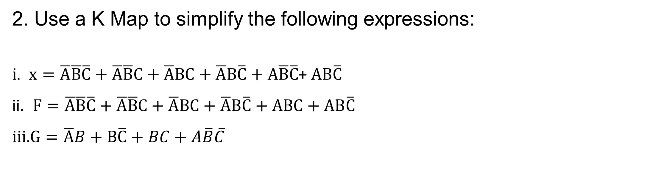
Additional exercises
2. Use a K Map to simplify the following expressions:
$x=\overline{A}\overline{B}\overline{C}+\overline{A}\overline{B}C+\overline{A}BC+\overline{A}B\overline{C}+A\overline{B}\overline{C}$+ $AB\overline{C}$
$F=\overline{A}\overline{B}\overline{C}+\overline{A}\overline{B}C+\overline{A}BC+\overline{A}B\overline{C}+ABC+AB\overline{C}$
$G=\overline{A}B+B\overline{C}+BC+A\overline{B}\overline{C}$

